Slide 1



ŠOK Į TĖVŲ KLUMPES 2023
Nacionalinė profesinio veiklinimo iniciatyva
Indra Gasiancevienė
Ugdymo karjerai skyrius
Lietuvos neformaliojo švietimo agentūra
Notes:
I am Indra representing Lithuanian non-formal education agency, department of career education.
My topic today is about professional development activities for students in general schools of Lithuania.

Slide 2
Profesinio orientavimo paslaugos
Ugdymas karjerai
Profesinis konsultavimas
Profesinis informavimas (įskaitant profesinį veiklinimą).
Notes:
For introduction to the topic, I would like to shortly mention about career services in general schools of Lithuania.
So, the services are dividing in three parts:
Career education,
Professional counseling
And Professional information (including professional development activities).
That means what professional development is just a part of big career services picture in general schools.

Slide 3
Profesinis veiklinimas
III lygis
II lygis
Intensyvus profesinis veiklinimas
I lygis
Patyriminiai vizitai
Pažintiniai vizitai
10-12 klasės
10-12 klasės
1-12 klasės
Lankausi
Asistuoju
Darau pats
Notes:
According to "Methodology of students' professional development activity" in Lithuania we have three possible levels how students could be involved in professional development activities.
Level 1. Simply we call „Just visiting“. In this level students are going to familiarization visits in different enterprises or organizations. This level is good for all general schools students from 1 til 12 grade.
Level 2. We call „Assisting“. In this level students are going to enterprises or organizations to have Professional activity experiential visits for one day. We recommend this level for 10-12 grades students.
And the highest third level we call „Doing by my self“ or „Intensive professional activity”. This level useful for 10-12 grades students because it could be practice, contract work, non-formal educational activities related to professional activity and similar forms, when students directly participate in the activities in enterprises or organization for more than two days.

Slide 4
Profesinio veiklinimo tikslai:
aktyviai pažinti įvairias darbo galimybes;
tyrinėti profesijų ypatumus;
kaupti darbo patirtį;
ugdytis profesinę motyvaciją;
planuoti būsimą karjerą;
pažinti save, aplinką, darbo rinką;
susipažinti su tam tikrų profesijų atstovais;
ugdytis karjeros kompetencijas.
Notes:
The goals of the initiative is:
• to provide from 1 till 12 grades students with professional development activity service;
• to develop students' career competencies, involving the students' parents (guardians) in this process,
• to introduce students to relatives' professions and physical workplaces.

Slide 5
„Šok į tėvų klumpes“ iniciatyvos tikslai:
suteikti 1–12 klasių mokiniams profesinio veiklinimo paslaugas;
ugdyti mokinių karjeros kompetencijas, įtraukiant į šį procesą mokinių tėvus (globėjus), supažindinant su artimųjų profesijomis ir fizinėmis darbo vietomis
Kasmet nuo 2015 m.
Laikotarpis: Balandžio – Birželio mėn.
Notes:
The goals of the initiative is:
• to provide from 1 till 12 grades students with professional development activity service;
• to develop students' career competencies, involving the students' parents (guardians) in this process,
• to introduce students to relatives' professions and physical workplaces.

Slide 6
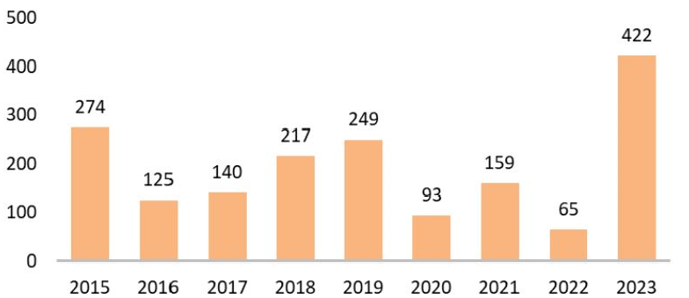
Į iniciatyvą „Šok į tėvų klumpes“ užsiregistravusių 2015-2023 metais švietimo įstaigų skaičius
Notes:
How it works:
In the beginning of April we are sending the formal letter for each general school inviting to join the national initiative "Jump into parents' clogs".
The career specialist of the school registers himself into the event registration form.
Each career specialist is dealing with school administration, students, parents (guardians), other teachers (class leads) about the possibilities to involve students and students' parents (guardians) to be part of the initiative.
After participation, a career specialist collects the main good experiences from students, parents (guardians), prepares a report (usually with pictures) and sends it to us.
We annually are collecting good experience about the professional development activities from all over Lithuania and then we are publishing it in the MUKIS (Information system of student education for careers).
We annually preparing general report about the received results and publishing into the MUKIS as well.

Slide 7
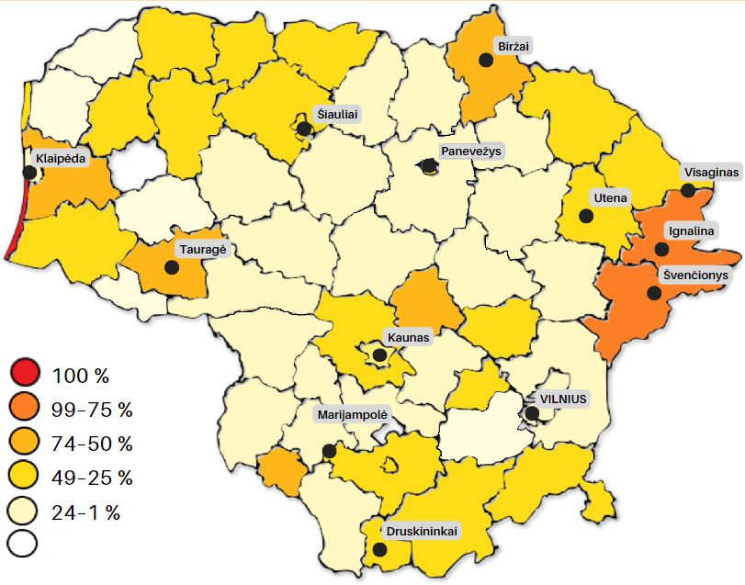
„Šok į tėvų klumpes 2023“
Nedalyvavo
Notes:
Shortly about „Jump into the parents‘ clogs 2023“ Here you can see the map of Lithuania. I hope I colored it right and you can see that in the map there are just one white spot. It‘s means that 59 municipals of Lithuania more or less actively were joined to the initiative „Jump into the parents‘ clogs“. A brighter color means municipals activity. In Lithuania we have 60 municipals. So, we can confidently say that the initiative „Jump into the parents‘ clogs“ is national.

Slide 8
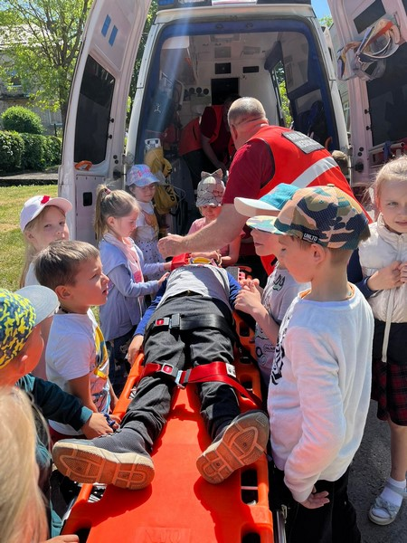
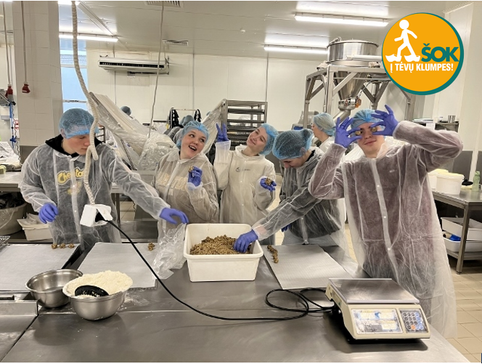
Pasidalinta geroji patirtis
Notes:
After the "Jump into parents' clogs 2023" initiative ended, the educational institutions registered in it were invited to share their best practices - to send descriptions of visits to parents' workplaces. All the collected descriptions of the good experiences are included in the information website for the career education of students, mukis.lt. Link

Slide 9
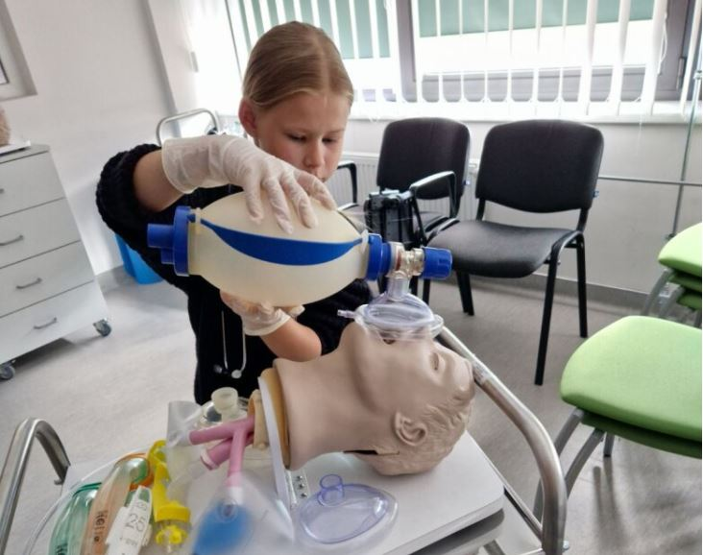
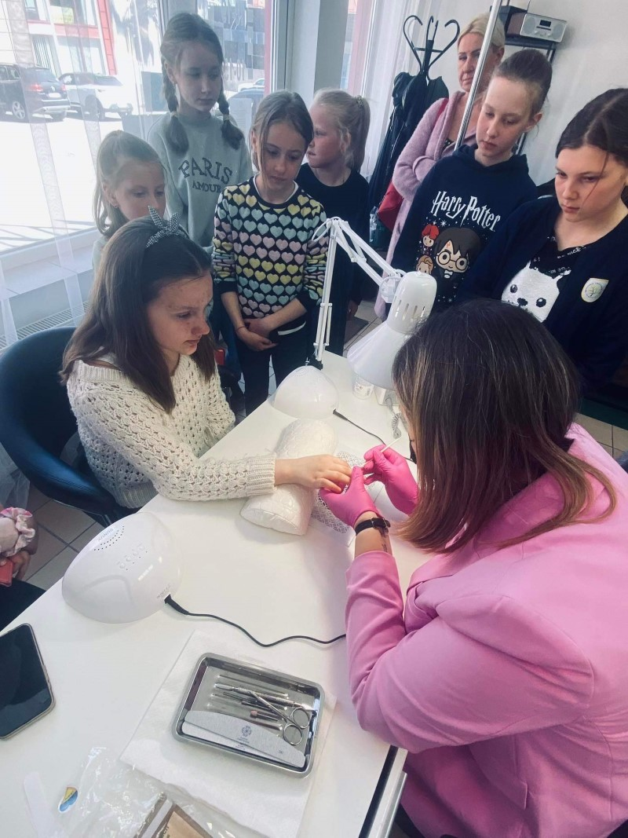

Slide 10
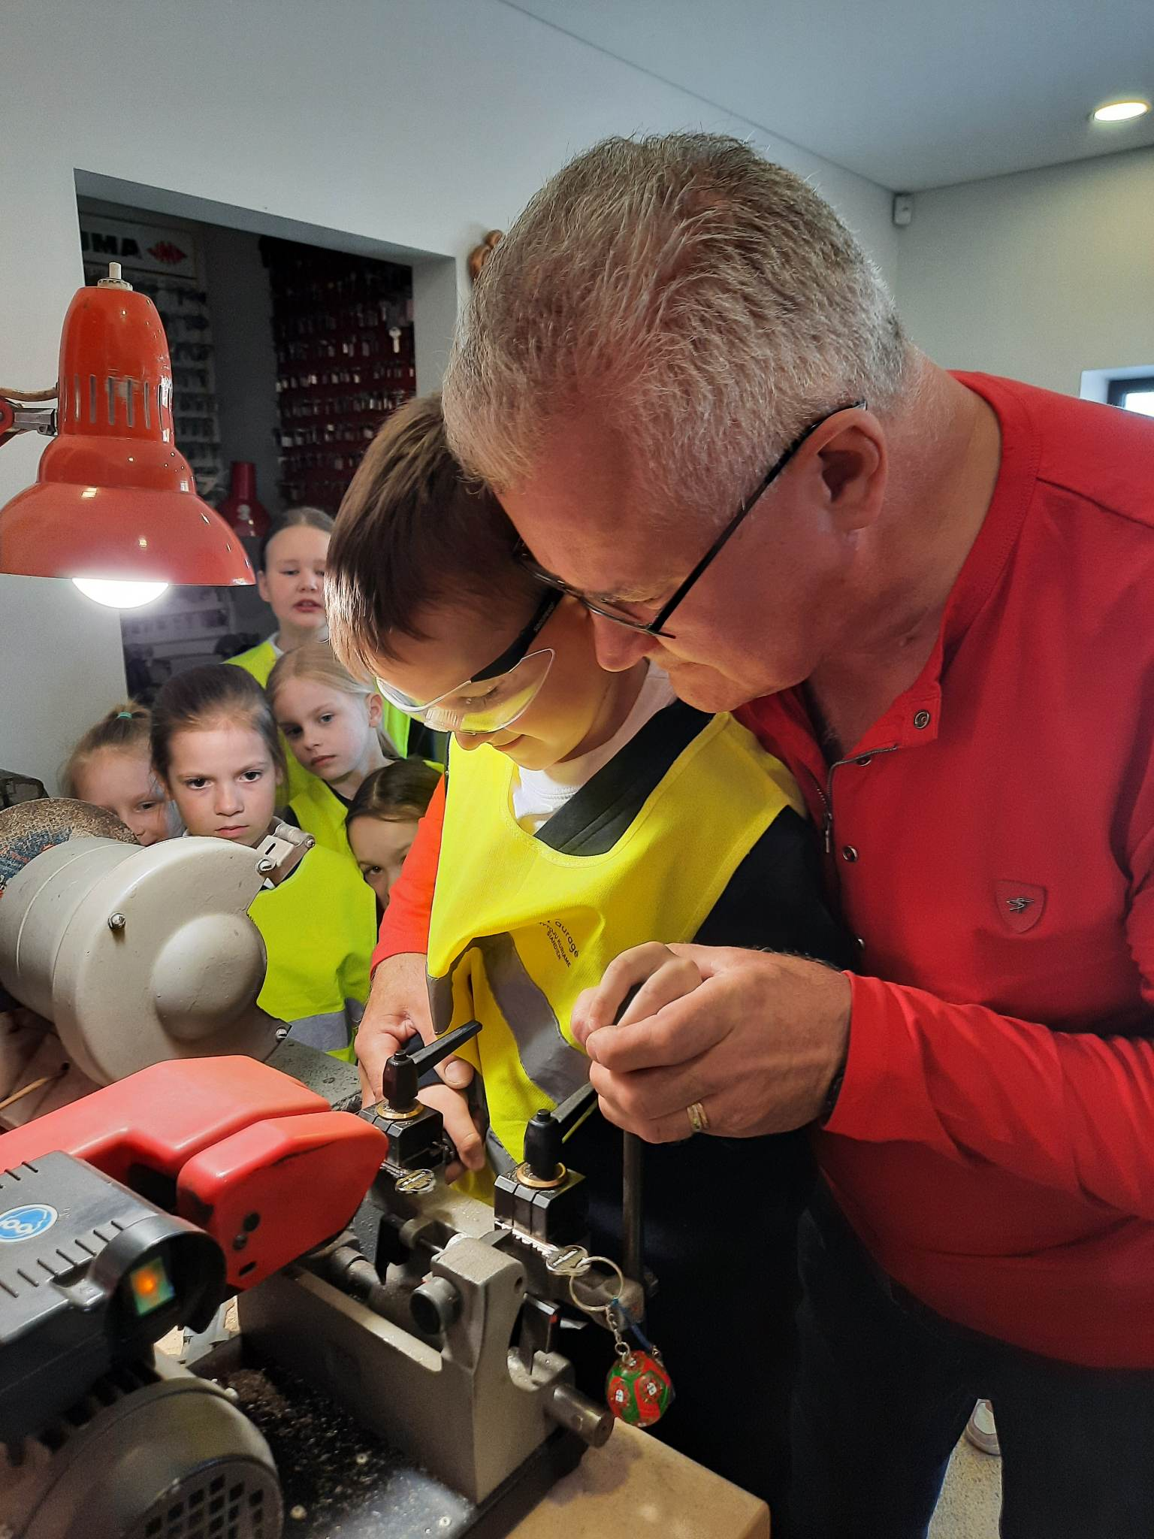
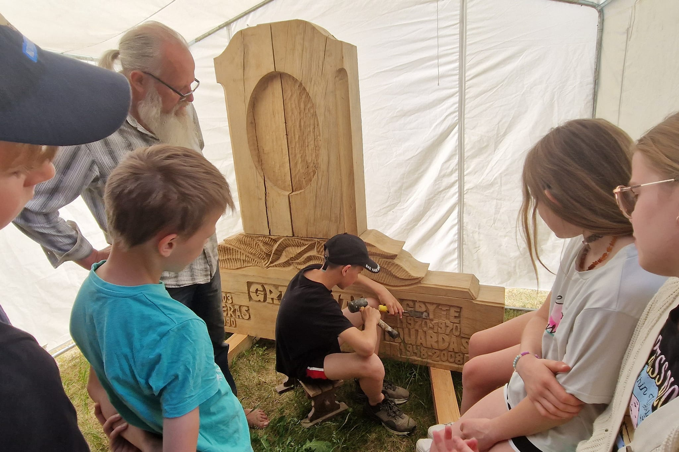

Slide 11
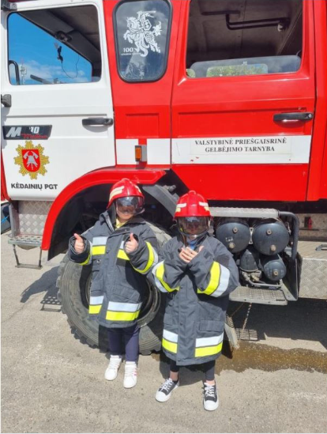
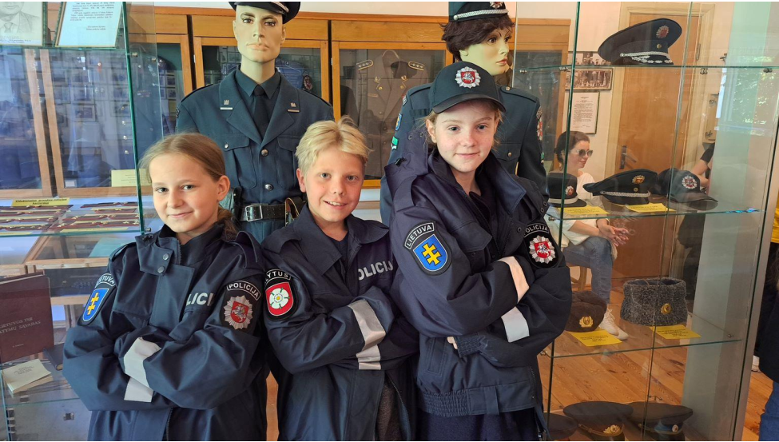

Slide 12
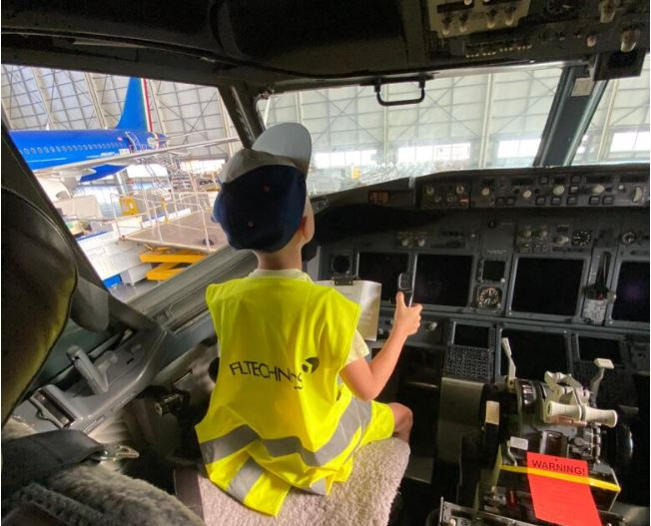
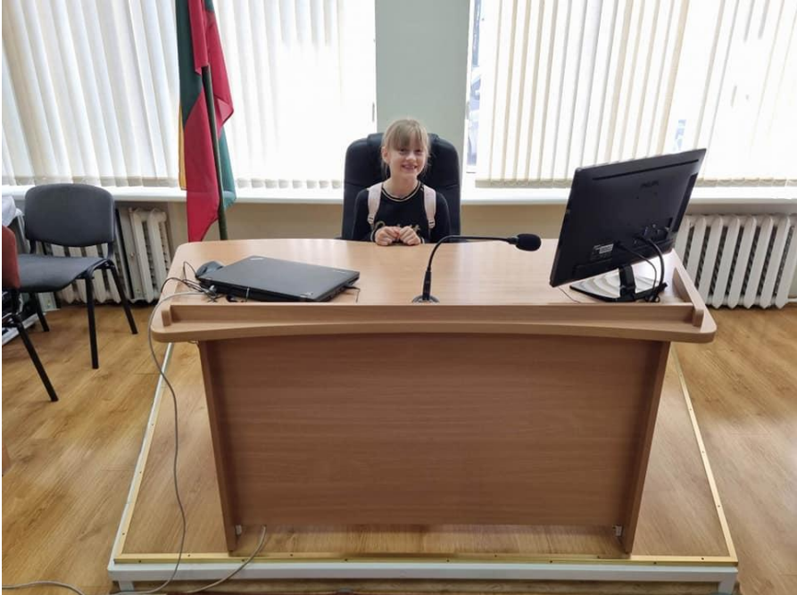
Notes:
According to the good experience reports we know that this initiative is full of advantages. Students get unforgettable experience. I can imagine it is so inspiring to try on police officer coat, to sit in police officer truck in the part of criminals, to sit in the judge or pilot chair and so on.

Slide 13
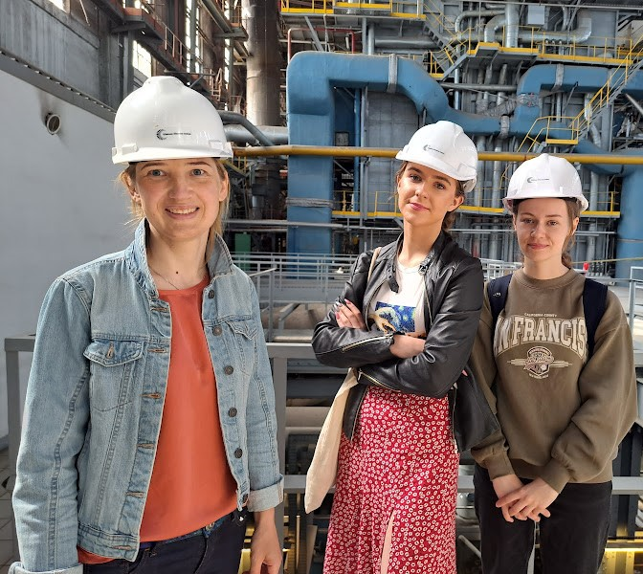
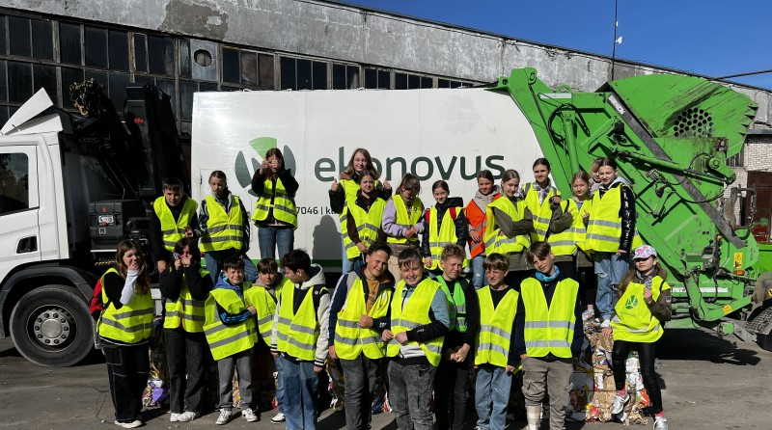

Slide 14
Nauda:
mokiniams (pažinti profesijų pasaulį ir kt.);
karjeros specialistams (kelti kompetenciją ir kt.);
mokykloms (partnerystė tinklo plėtimas ir kt.);
tėvams (globėjams) (stiprinti ryši su vaiku ir kt.);
įmonių / įstaigų / organizacijų verslo vienetams (bendradarbiavimo su švietimo įstaigomis galimybė, potencialaus darbdavio reprezentacija ir kt.);
iniciatoriams (motyvacija).
Notes:
The goals of the initiative is:
• to provide from 1 till 12 grades students with professional development activity service;
• to develop students' career competencies, involving the students' parents (guardians) in this process,
• to introduce students to relatives' professions and physical workplaces.

Slide 15
Rezultatai 2023:
Iniciatyvoje dalyvavo:
422 švietimo įstaigos;
59 savivaldybės;
34,367 mokiniai;
2,304 karjeros specialistai ir kiti pedagogai (klasių vadovai ir kt.);
1,954 mokinių tėvai (globėjai) ir kiti giminaičiai.
1,765 darbovietės buvo aplankytos.
Mokiniai susipažino su 1,604 profesijomis, iš kurių 536 unikalios.
Notes:
The initiative involved:
422 schools;
59 municipalities;
More then 34,000 students;
More then 2,300 career specialists and other teachers;
Almost 2000 parents (guardians), other relatives.
Almost 1,800 workplaces were visited.
students got knowledge about 1,604 professions, of which 536 are unique.

Slide 16

Plačiau apie rezultatus
www.mukis.lt

Slide 17

Indra Gasiancevienė
Indra.gasianceviene@linesa.lt
Ugdymo karjerai skyrius,
LINEŠA

